Slide 1
Risk-Risk Correlation
Overview for simulation science team informed by GBD 2019

Slide 2
First… for correlated risks that affect the same outcome

Slide 3
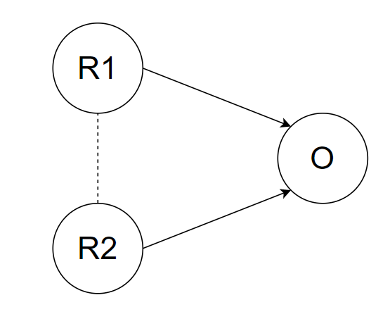
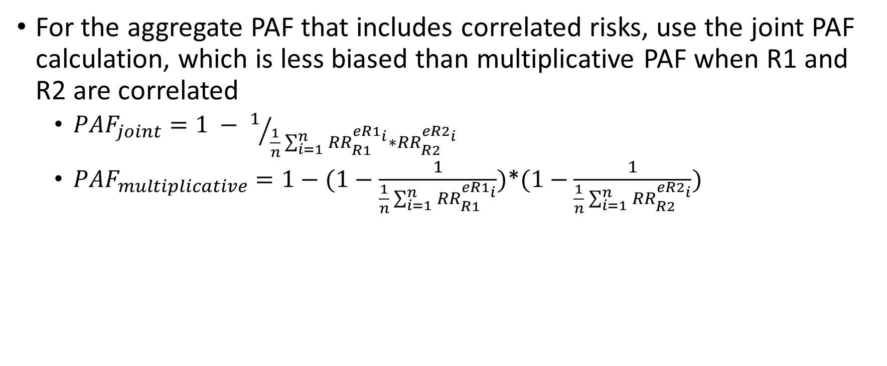
From BEP Project and Chris’ Proposal
For the aggregate PAF that includes correlated risks, use the joint PAF calculation, which is less biased than multiplicative PAF when R1 and R2 are correlated
$PAF_{joint}=1 − 1/{\frac{1}{n}\sum_{i=1}^{n}{{RR}_{R1}^{eR1_{i}}∗{RR}_{R2}^{eR2_{i}}}}$
$PAF_{multiplicative}=1−(1−\frac{1}{\frac{1}{n}\sum_{i=1}^{n}{{RR}_{R1}^{eR1_{i}}}})$*$(1−\frac{1}{\frac{1}{n}\sum_{i=1}^{n}{{RR}_{R2}^{eR2_{i}}}})$

Slide 4
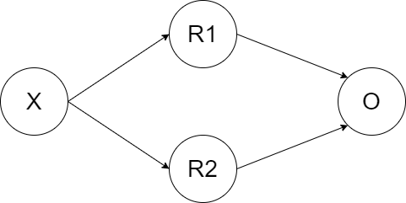
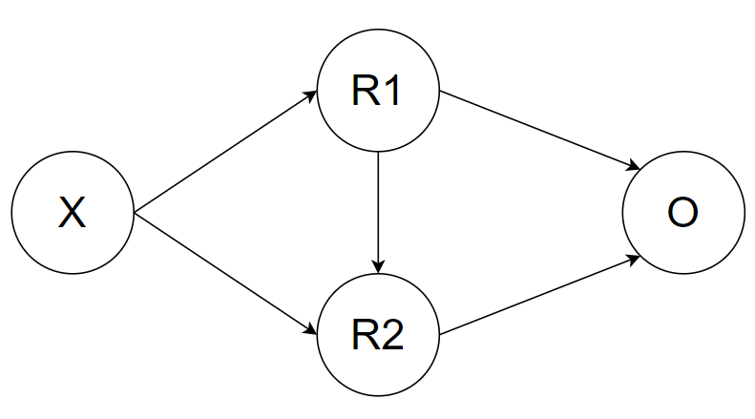
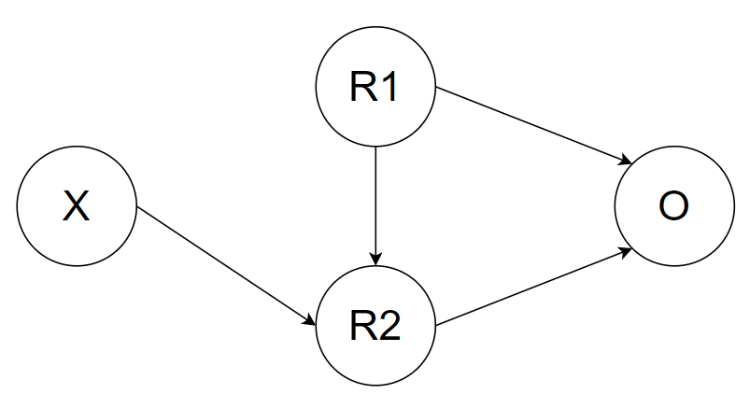
But what do we mean by correlated risks?

Slide 5
Correlation through a common cause
Risk factors are correlated, but not causally related
Effect of each risk on outcome subject to confounding by the other
GBD already takes care of this for us, as risk effects are adjusted for confounding
Ensure extracted RRs for non-GBD risks are appropriately adjusted for confounding
Use the joint PAF as described in proposal
Risk exposures assigned to simulants according to correlation coefficients
If one risk exposure is intervened on, the other risk exposure remains unchanged

Slide 6
Correlation through causation
Risk factors are correlated (at least partially) through R1’s effect on R2
Effect of R1 on O is mediated by R2
Effect of R2 on O is confounded by R1
How to calculate effects/PAFs for each risk?
R1 direct (excluding mediated effect through R2)
R1 indirect (excluding the direct effect)
R1 total (including mediated effect through R2)
R2 unadjusted for R1 (confounded by R1)
R2 adjusted for R1 (causal)

Slide 7
… so how does GBD handle joint PAFs and mediation?

Slide 8
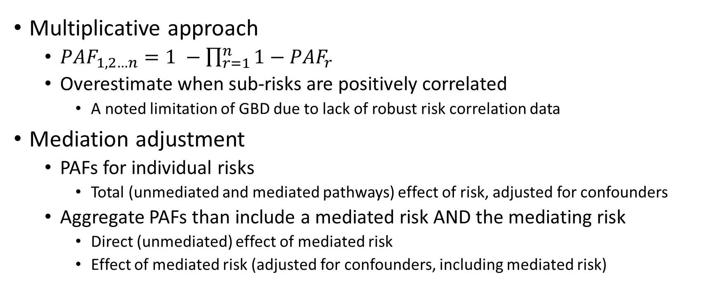
GBD aggregate PAF estimation
Multiplicative approach
$PAF_{1,2…n}=1 −\prod_{r=1}^{n}{1−PAF_{r}}$
Overestimate when sub-risks are positively correlated
A noted limitation of GBD due to lack of robust risk correlation data
Mediation adjustment
PAFs for individual risks
Total (unmediated and mediated pathways) effect of risk, adjusted for confounders
Aggregate PAFs than include a mediated risk AND the mediating risk
Direct (unmediated) effect of mediated risk
Effect of mediated risk (adjusted for confounders, including mediated risk)

Slide 9
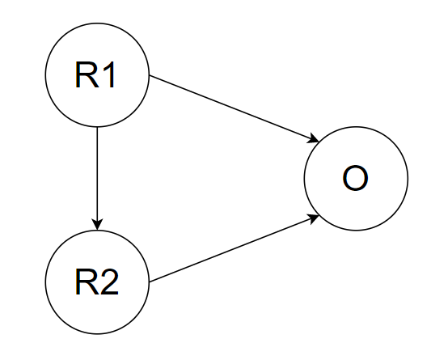

GBD mediation factor calculation
$MF=\frac{RR_{crude}−RR_{adjusted}}{RR_{crude}−1}$
$MF:mediation factor$
Proportion of the excess risk attributable to the mediated effect
(1-MF) : proportion of the excess risk attributable to the direct effect
$RR_{crude}:RR of R1 on O, adjusted for confounders only$
$RR_{adjusted}:RR of R1 on O, adjusted for confounders and R2$

Slide 10
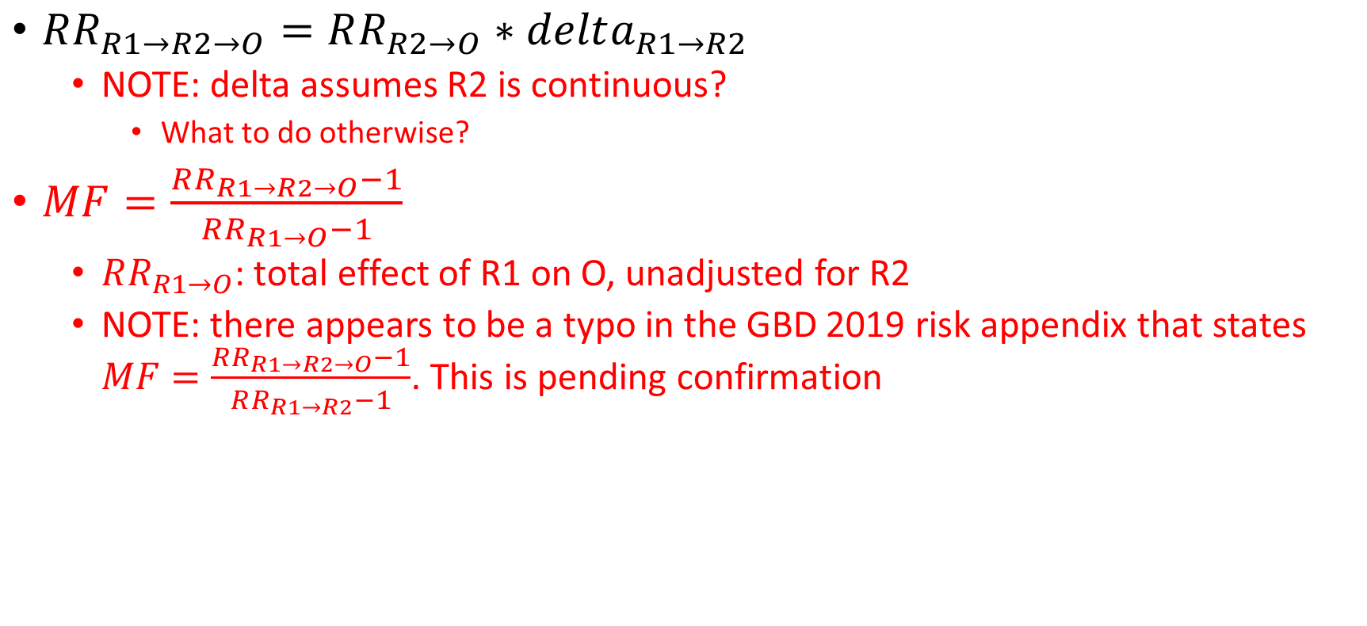
GBD mediation factor calculation (when data is limited)
$RR_{R1→R2→O}=RR_{R2→O}∗delta_{R1→R2}$
NOTE: delta assumes R2 is continuous?
What to do otherwise?
$MF=\frac{RR_{R1→R2→O}−1}{RR_{R1→O}−1}$
$RR_{R1→O}$: total effect of R1 on O, unadjusted for R2
NOTE: there appears to be a typo in the GBD 2019 risk appendix that states $MF=\frac{RR_{R1→R2→O}−1}{RR_{R1→R2}−1}$. This is pending confirmation

Slide 11
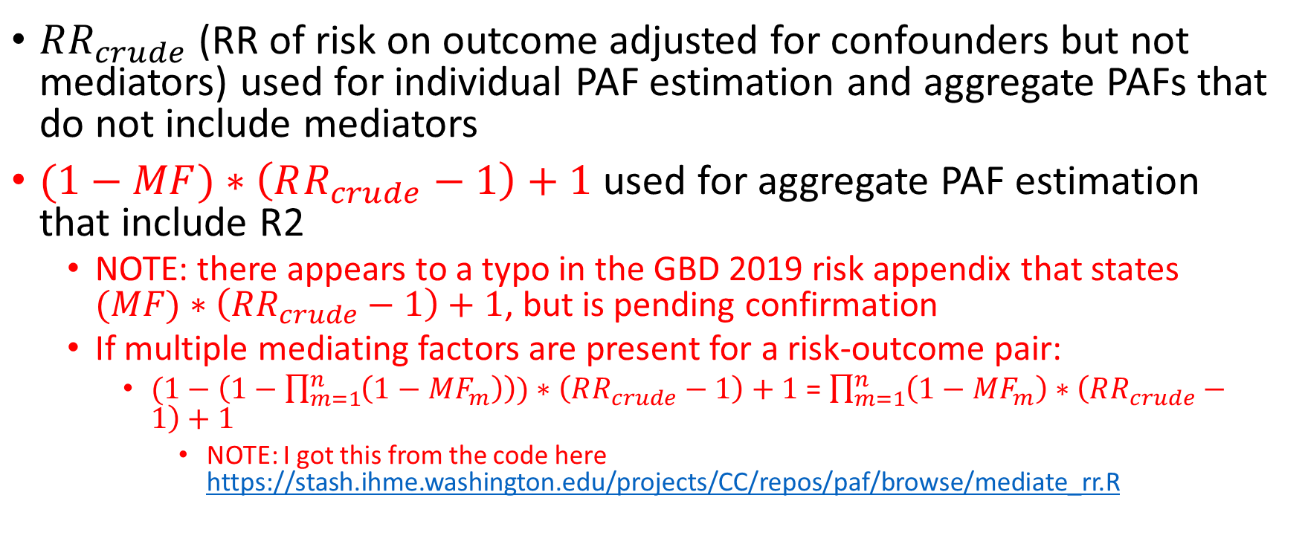
GBD mediation factor application
$RR_{crude}$ (RR of risk on outcome adjusted for confounders but not mediators) used for individual PAF estimation and aggregate PAFs that do not include mediators
$(1−MF)∗\left(RR_{crude}−1\right)+1$ used for aggregate PAF estimation that include R2
NOTE: there appears to a typo in the GBD 2019 risk appendix that states $(MF)∗\left(RR_{crude}−1\right)+1$, but is pending confirmation
If multiple mediating factors are present for a risk-outcome pair:
$(1−\left(1−\prod_{m=1}^{n}{\left(1−MF_{m}\right)}\right))∗\left(RR_{crude}−1\right)+1$ = $\prod_{m=1}^{n}{\left(1−MF_{m}\right)}∗\left(RR_{crude}−1\right)+1$
NOTE: I got this from the code here https://stash.ihme.washington.edu/projects/CC/repos/paf/browse/mediate_rr.R

Slide 12
GBD IHD Mediation
Direct pathways

Slide 13
GBD IHD Mediation
Mediated pathways for physical activity

Slide 14
GBD IHD Mediation
All mediation pathways (direct pathways not shown)

Slide 15
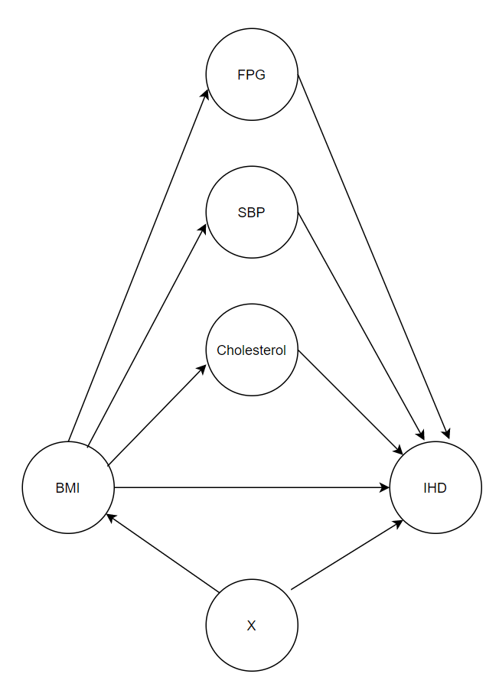
First let’s focus on BMI…
BMI effect on IHD mediated through SBP, cholesterol, and FPG; confounded by variable X (ex: sex, age, etc.)
Effect of FPG, SBP, and cholesterol on IHD confounded by BMI (and other variables such as sex, age, etc.)
So…

Slide 16
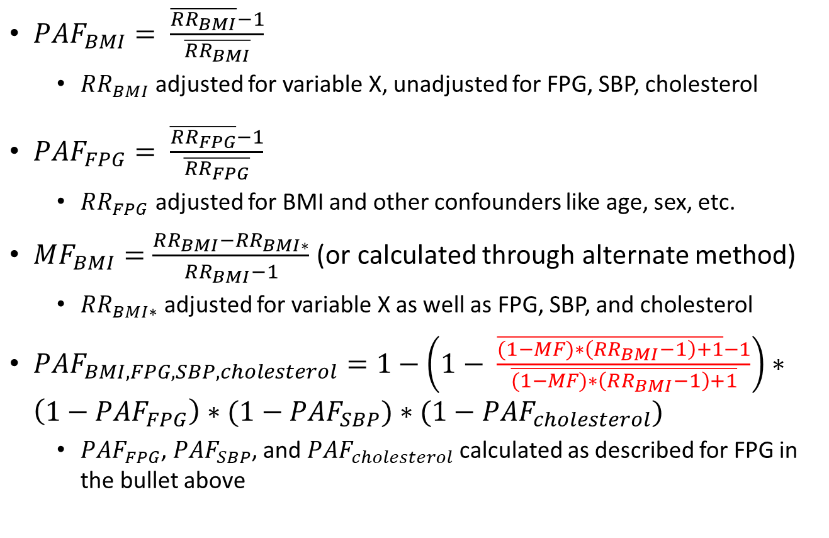
GBD IHD PAFs
$PAF_{BMI}= \frac{\overline{RR_{BMI}}−1}{\overline{RR_{BMI}}}$
$RR_{BMI}$ adjusted for variable X, unadjusted for FPG, SBP, cholesterol
$PAF_{FPG}= \frac{\overline{RR_{FPG}}−1}{\overline{RR_{FPG}}}$
$RR_{FPG}$ adjusted for BMI and other confounders like age, sex, etc.
$MF_{BMI}=\frac{RR_{BMI}−RR_{BMI∗}}{RR_{BMI}−1}$ (or calculated through alternate method)
$RR_{BMI∗}$ adjusted for variable X as well as FPG, SBP, and cholesterol
$PAF_{BMI,FPG,SBP,cholesterol}=1−\left(1− \frac{\overline{(1−MF)∗\left(RR_{BMI}−1\right)+1}−1}{\overline{(1−MF)∗\left(RR_{BMI}−1\right)+1}}\right)∗\left(1−PAF_{FPG}\right)∗(1−PAF_{SBP})$ $∗(1−PAF_{cholesterol})$
$PAF_{FPG}$, $PAF_{SBP}$, and $PAF_{cholesterol}$ calculated as described for FPG in the bullet above

Slide 17
A more complicated example: multi-layer mediation
Have to figure out how to handle this!

Slide 18
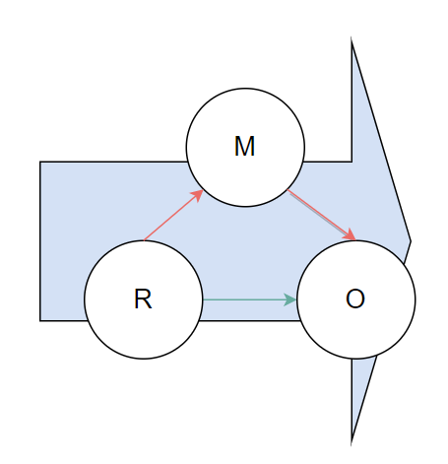
Terminology moving forward
Total effect
Direct (non-mediated) effect
Indirect (mediated) effect

Slide 19
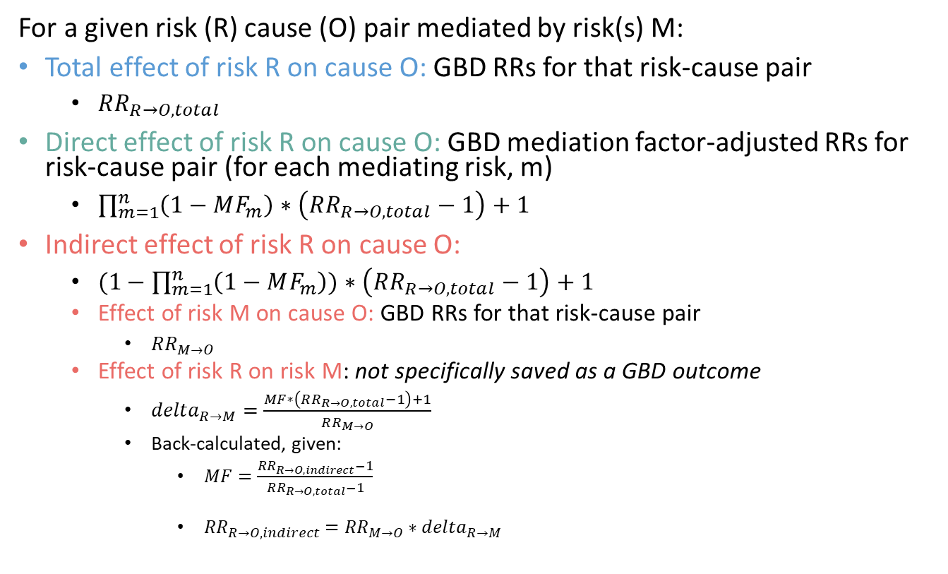
GBD Mediated Risk Effects
For a given risk (R) cause (O) pair mediated by risk(s) M:
Total effect of risk R on cause O: GBD RRs for that risk-cause pair
$RR_{R→O, total}$
Direct effect of risk R on cause O: GBD mediation factor-adjusted RRs for risk-cause pair (for each mediating risk, m)
$\prod_{m=1}^{n}{\left(1−MF_{m}\right)}∗\left(RR_{R→O,total}−1\right)+1$
Indirect effect of risk R on cause O:
$(1−\prod_{m=1}^{n}{\left(1−MF_{m}\right))}∗\left(RR_{R→O,total}−1\right)+1$
Effect of risk M on cause O: GBD RRs for that risk-cause pair
$RR_{M→O}$
Effect of risk R on risk M: not specifically saved as a GBD outcome
$delta_{R→M}=\frac{MF∗\left(RR_{R→O,total}−1\right)+1}{RR_{M→O}}$
Back-calculated, given:
$MF=\frac{RR_{R→O,indirect}−1}{RR_{R→O,total}−1}$
$RR_{R→O,indirect}={RR}_{M→O}∗delta_{R→M}$

Slide 20
Additional GBD Mediation factor details
Truncate mediation factor distribution at 1
Allowed negative draws, but excluded mediation networks if there were more than 50 negative draws
Mediation assumed not to vary by location, age, sex, or year
GBD has a “mediation matrix” of all risk-mediator-cause pairs in GBD and associated mediation factors
This is being updated in GBD 2020

Slide 21
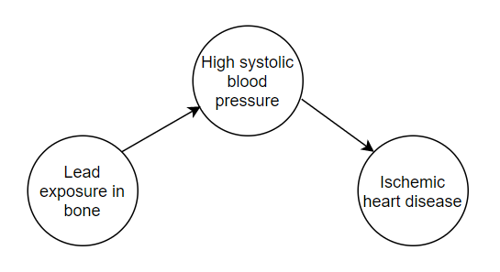
Additional GBD mediation details
There are some risk/cause pairs in GBD that are entirely mediated by another risk factor
MF = 1
No direct effect of risk on cause
“Mediator” is an intermediate on the pathway between the risk and cause
Ex: lead exposure in bone entirely mediated through SBP
Effect of lead on IHD adjusted for SBP = 0

Slide 22
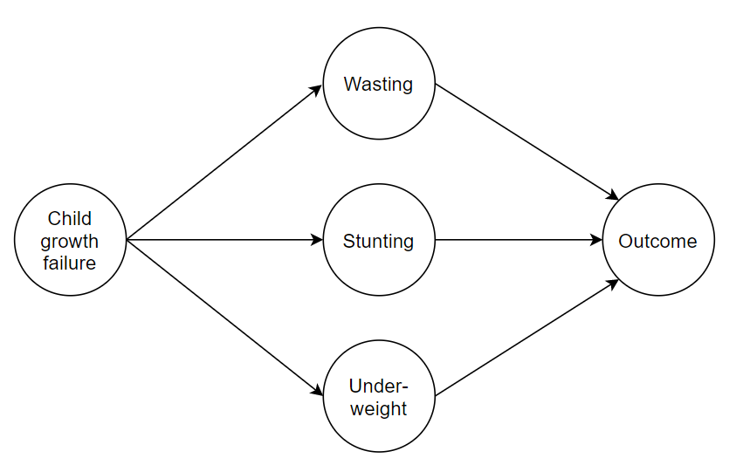
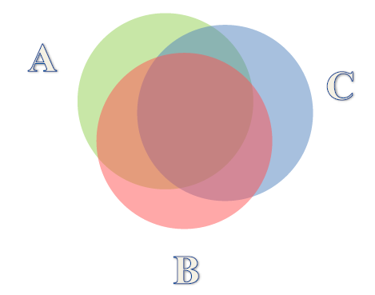
GBD Child growth failure
CGF not directly modeled as a risk; rather, estimated as an aggregate of wasting, stunting, underweight
Wasting, stunting, and underweight exposures are highly correlated, most RRs are not adjusted for each other
Joint PAF calculation without considering covariance would highly overestimate
GBD calculated RRs adjusted for the other measures and then aggregated for CGF PAF
No mediation present here
Allows for assessment of impact of CGF on outcome of interest rather than sub-risks individually

Slide 23
Correlated risks in Vivarium
Assigning correlated risk exposures
Use unadjusted, total measures of association between correlated risks in our simulation to assign risk exposures to simulants, regardless of whether mediation is present
Goal is to capture the aggregate impact of unmodelled common causes
Applying risk effects of correlated risks
When mediation is not present among modeled correlated risks
Use joint PAF calculation rather than multiplicative PAF calculation
Use relative risks adjusted for confounding in calculation of the joint PAF
When mediation is present among modeled correlated risks
Use joint PAF calculation rather than multiplicative PAF calculation
Use relative risks adjusted for confounding AND mediation in the calculation of the joint PAF

Slide 24
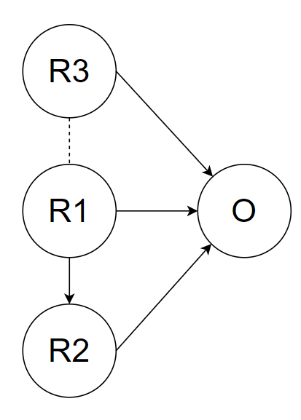
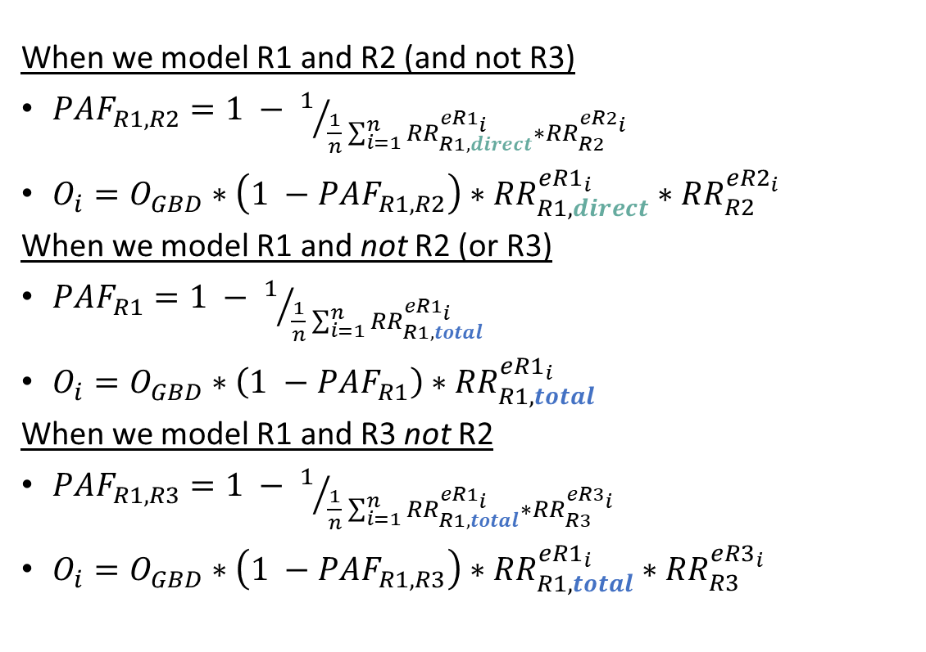
Risk effects for correlated risks
When we model R1 and R2 (and not R3)
$PAF_{R1,R2}=1 − 1/{\frac{1}{n}\sum_{i=1}^{n}{{RR}_{R1,direct}^{{eR1}_{i}}∗{RR}_{R2}^{{eR2}_{i}}}}$
$O_{i}=O_{GBD}∗\left(1 −PAF_{R1,R2}\right)∗{RR}_{R1,direct}^{{eR1}_{i}}∗{RR}_{R2}^{{eR2}_{i}}$
When we model R1 and not R2 (or R3)
$PAF_{R1}=1 − 1/{\frac{1}{n}\sum_{i=1}^{n}{{RR}_{R1,total}^{{eR1}_{i}}}}$
$O_{i}=O_{GBD}∗\left(1 −PAF_{R1}\right)∗{RR}_{R1,total}^{{eR1}_{i}}$
When we model R1 and R3 not R2
$PAF_{R1,R3}=1 − 1/{\frac{1}{n}\sum_{i=1}^{n}{{RR}_{R1,total}^{{eR1}_{i}}∗{RR}_{R3}^{{eR3}_{i}}}}$
$O_{i}=O_{GBD}∗\left(1 −PAF_{R1,R3}\right)∗{RR}_{R1,total}^{{eR1}_{i}}∗{RR}_{R3}^{{eR3}_{i}}$

Slide 25
What if there is risk exposure correlation via a common cause and mediation (scheme B)?
A.
For A and B, calculate PAFs and apply relative risks in the same manner as described for mediated risks
For A and B, use unadjusted total correlation to assign correlated risk exposures, as for all correlated risk pairs
For A (but not B), the unadjusted correlation between R1 and R2 will be equal to the modeled causal impact of R1 and R2
Unrealistic, but important to note if making this assumption
Intended to highlight the difference between the adjusted and unadjusted measures of association
B.

Slide 26
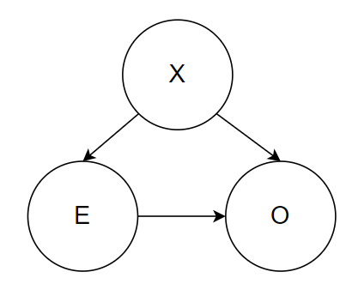
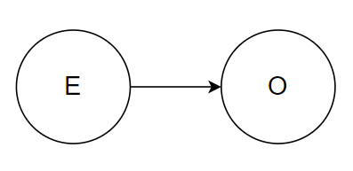
In other words…
Unlikely that this is the full picture in the real world
More likely something like this!

Slide 27
Intervening on correlated risks
A.
Intervention changes R1 exposures and has no direct impact on R2 exposures
Scheme A
No impact on R2 exposures
Impact on O entirely through effect of R1
Correlation between R1 and R2 will be attenuated in the intervention scenario
Scheme B
R2 exposures will change in accordance with the impact of R1 on R2
Impact on O partially mediated through R2
Correlation between R1 and R2 will be unaffected in the intervention scenario
Scheme C
R2 exposures will change in accordance with the impact of R1 on R2
Impact on O partially mediated through R2
Correlation between R1 and R2 will be affected in the intervention scenario, but to a lesser degree than in scheme A
B.
C.

Slide 28
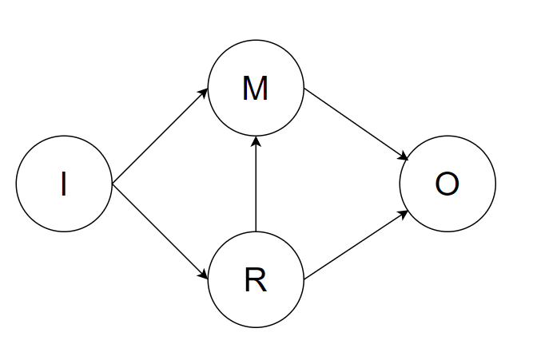
When should and shouldn’t we model mediation?
Intervention literature reports total effect of I on R1 and R2
Most likely scenario
Model only the correlation, not causation between R and M
Don’t want to double count the impact of the intervention

Slide 29
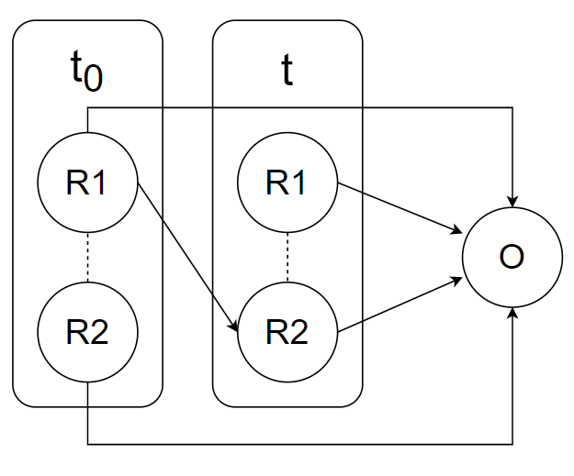
Correlated risks across time
Risk effects may not occur instantaneously!
Perhaps there is a delay of some duration, t
The duration of t should be informed by the literature from which the effect size for R1 on R2 was extracted

Slide 30
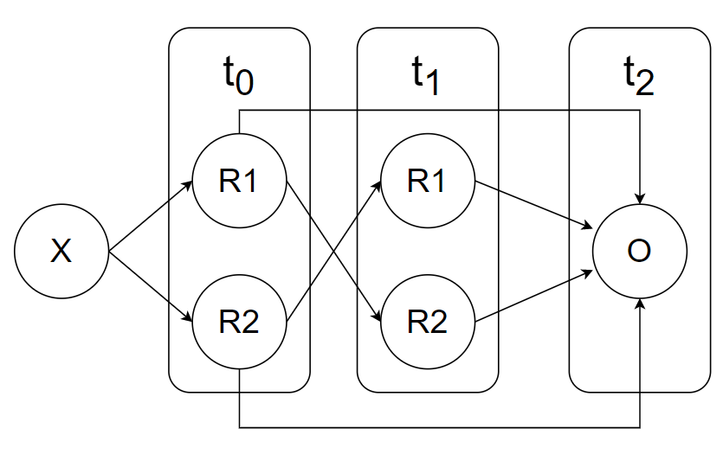
“Vicious cycle”
Effect of R1 at t0 on O at t2 is mediated through R2 at time t1, effect of R2 at t0 on O at t2 is mediated through R1 at time t1
Ideal effect sizes to use (duplicated for R2)
R1 at t0 on O at t2: adjusted for confounding by R2 at t0, adjusted for mediation through R2 at t1
R1 at t1 on O at t2: adjusted for confounding by R2 at t0
R1 at t0 on R2 at t1: no need for adjustment by represented variables

Slide 31
Vicious cycle effect sizes
May be difficult to find effect of R1 at t0 on O at t2 adjusted for confounding by R2 at t0 and adjusted for mediation through R2 at t1
Ideally would come from a robust longitudinal study with multiple follow-up data collection points
If unavailable, may need to make assumptions
Adjust for mediation using mediation factor method described by GBD strategy when data is limited
May need to restructure the time that the outcome occurs relative to the time of risk exposure differently than represented in this figure (alternate example shown on next slide)

Slide 32
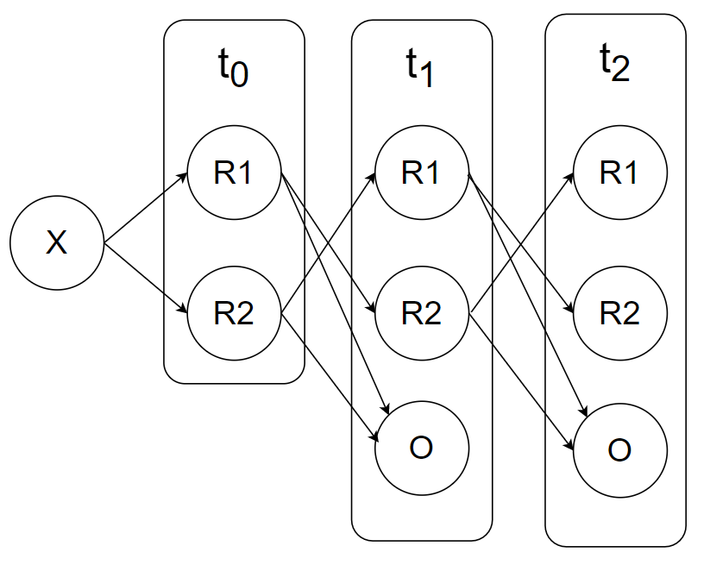
Alternate vicious cycle structure
Effect sizes to use (duplicate for R2)
R1 at t0 on O at t1: adjusted for confounding by R2 at t0
R1 at t1 on O at t2: adjusted for confounding by R2 at t1 or R1 at t0 or R2 at t0
No need to adjust for mediation!
Should design causal diagram in accordance with available evidence and evaluate how to handle confounding and mediation accordingly

Slide 33
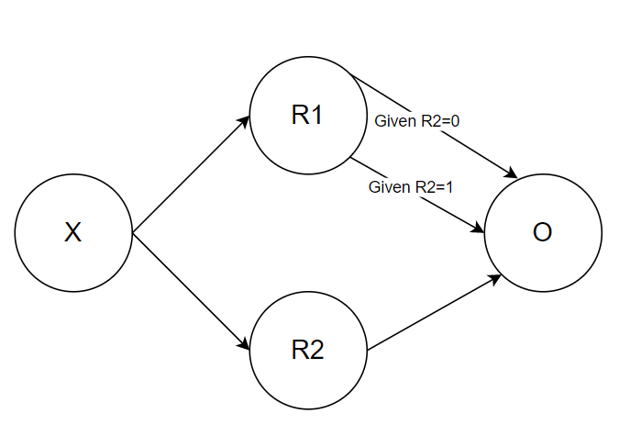
What about effect modification?
Stratify risk effects by effect modifier exposure status!
In this case, exposures should be assigned in the same way as previously described, in accordance with the correlation coefficient between R1 and R2 (unaffected by presence of effect modification)
Apply effect of R1 on O stratified by R2 exposure status or according to interaction

Slide 34
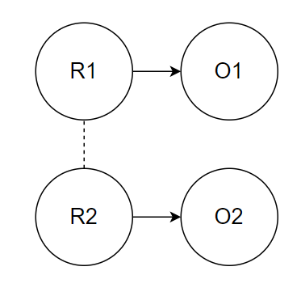
Now, for risks that are correlated, but affect different outcomes
We can relax a bit about confounding, joint PAFs, and mediation! ☺
But we might need to worry about intermediates.

Slide 35
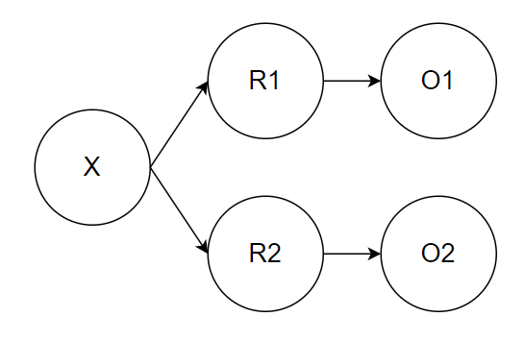
Common cause example
Model correlated risk exposures
Change in one risk exposure does not affect the other
No confounding or mediation between modeled risks and outcomes
PAF for O1 of all modeled risk exposures is the individual PAF attributable to R1
PAF for O2 of all modeled risk exposures is the individual PAF attributable to R2
Easy ☺

Slide 36
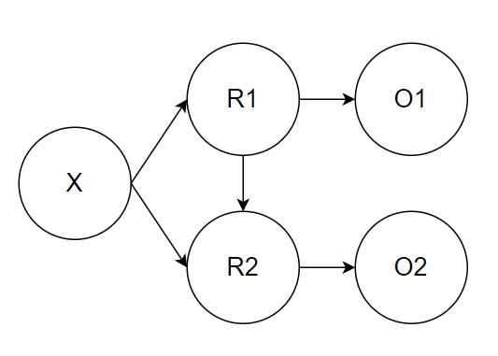
Common cause and direct cause example
Model correlated risk exposures
Change in one risk exposure does affect the other
No confounding or mediation between modeled risks and outcomes
PAF for O1 of all modeled risk exposures is the individual PAF attributable to R1
R2 is an intermediate variable in the causal pathway between R1 and O2
Should decide which variable (or both) is the most appropriate to model
If intervening on R1 only, consider modeling direct impact of R1 to O2 and not modeling R2
If intervening on R2 only, consider modeling only the correlation (and not causation) between R1 and R2
If intervening on R1 and R2, model the unadjusted correlation of risk exposures AND the adjusted causal risk effect of R1 and R2

Slide 37
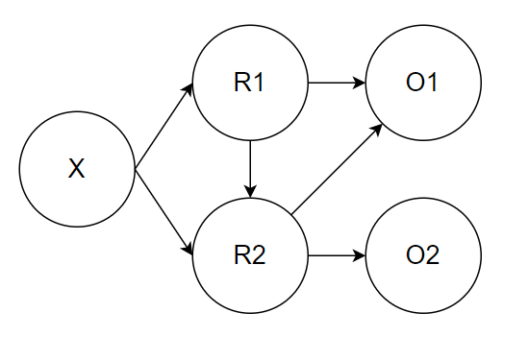
A hybrid example
Effect of R1 on O1 partially mediated through R2
Need to consider this in model
Effect of R2 on O1 confounded through X/R1
Ensure relative risk used in model is adjusted appropriately
R2 is an intermediate on the causal pathway between R1 and O2
Need to consider which risks to model explicitly depending on which risks will be intervened on like on last slide
Effect of R2 on O2 not confounded or mediated by modeled variables

Slide 38
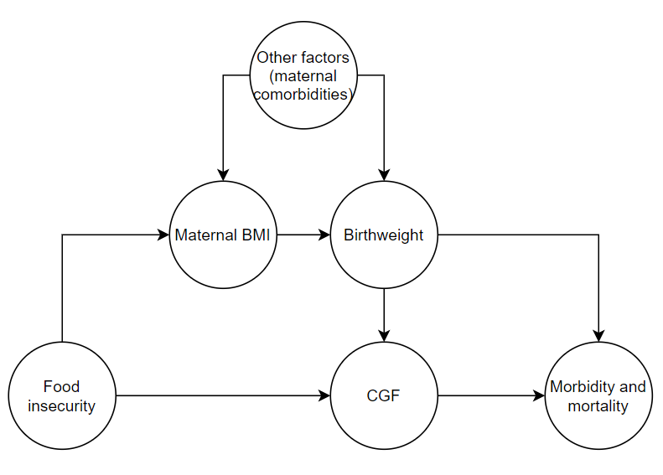
A Vivarium Example: BEP
Effect of BW on M&M partially mediated through CGF, confounded by common cause (food insecurity)
Effect of CGF on M&M confounded by common cause (food insecurity)
BUT….

Slide 39
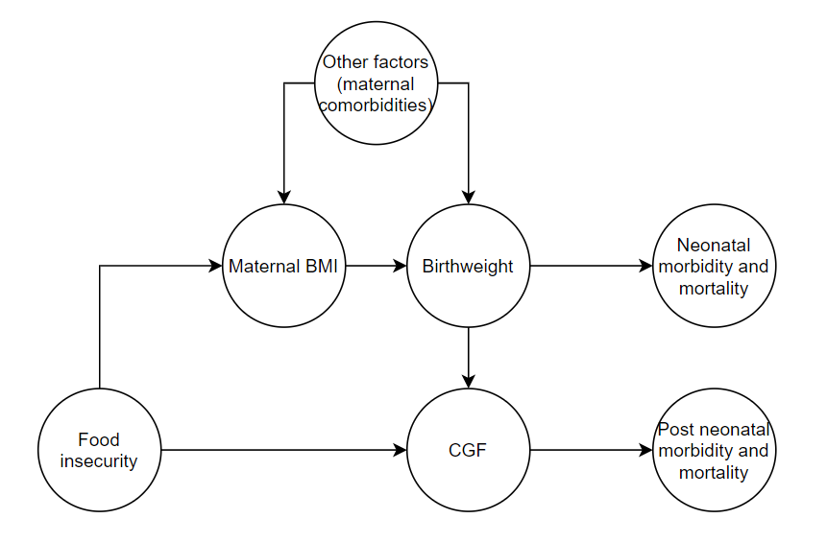
GBD structures these risks at different times
When differentiating between neonatal and post neonatal morbidity and mortality outcomes, we no longer see the mediation relationship for our M&M outcome(s) of interest
Now, we only have correlation between birth weight and CGF, which is partially attributable to a potential causal effect of birthweight and partially attributable to a common cause of food insecurity
So now we need to choose if we want to model a change in CGF exposure associated with a change in birthweight exposure…

Slide 40
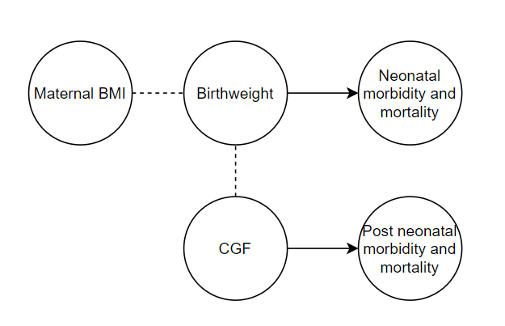
Final causal diagram
There wasn’t great evidence to inform the causal effect of BW on CGF
Chose to only model the correlation due to some shared common cause (i.e. food insecurity) between these two risks
Did we need to differentiate between correlation and causation between maternal BMI and BW?
Not intervening on these variables, so we only need to capture correlation
NOTE: maternal BMI and CGF are implicitly correlated as a result of this structure even though a correlation coefficient between them isn’t explicitly applied/enforced

Slide 41
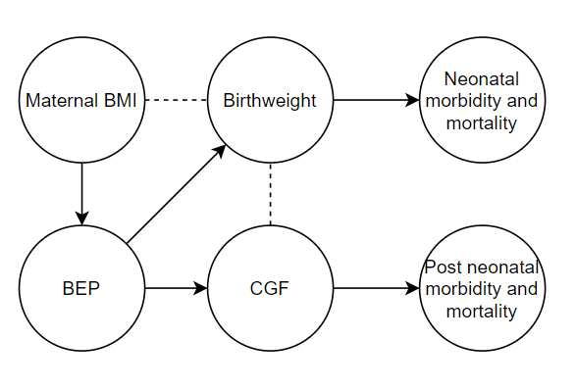
Incorporating the intervention
Association between maternal BMI and BW now influenced by BEP exposure
Luckily, BEP exposure believed to be near zero in data sources that reported on the association of maternal BMI on BEP, so it likely did not influence the data that informed our model
Note that the introduction of BEP in the intervention scenario will alter the correlation between maternal BMI and BW as well as BW and CGF compared to the baseline scenario
Note: maternal BMI in this diagram is specific to pre-BEP BMI. Post-BEP maternal BMI is causally affected by BEP, but we do not model this as a simulation outcome, so it is not represented in this diagram

Slide 42
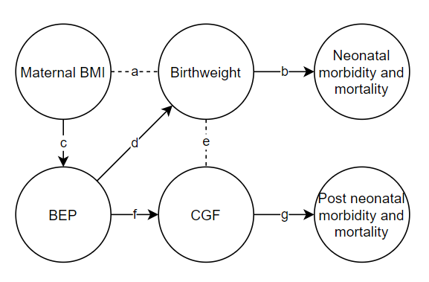
Final BEP Model Effects
a: crude association of maternal BMI and BW
b: GBD risk effect
c: effect of maternal BMI on probability of receiving BEP
d: effect of BEP on BW, controlled for confounding by maternal BMI
Note: BEP effect comes from RCT, so there is no opportunity for confounding by maternal BMI as there would be in an observational study
We additionally incorporated effect modification by maternal BMI, but this did not change causal structure
f: effect of BEP on CGF, controlled for confounding by birthweight (and maternal BMI if effect came from an observational study)
This was a difficult estimate to come across, so we performed sensitivity analysis around this variable
g: GBD risk effect

Slide 43
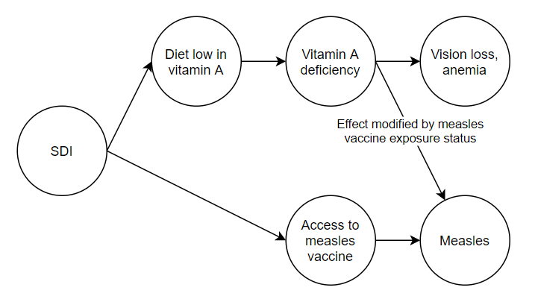
Another example: Vitamin A and Measles
Vitamin A deficiency and access to measles vaccine correlated through shared common cause of social demographic index
Effect of vitamin A deficiency modified by access to measles vaccine exposure status
Protective among unvaccinated only
Need to ensure effect sizes of VAD and measles vaccination on measles are adjusted for each other due to potential confounding
Things GBD does not consider, but that we would like to:
Measles vaccine as a risk factor for measles
Effect modification of VAD on measles by vaccination status
Correlated exposures of VAD and measles vaccination

Slide 44
In conclusion
It all depends on the causal diagram structure (re: confounding, mediation)
Use joint PAF calculation rather than multiplicative PAF calculation for aggregate PAFs composed of risks that are correlated
If mediation is present among modeled risks, be careful to use the direct (unmediated/mediation factor adjusted) effect sizes of the mediated risk factor on the outcome for PAF calculation and relative risk application
Be careful with time steps. Remember:
Causal diagrams cannot contain cyclical relationships (must separate time points in order to appropriately distinguish confounders and mediation relationships)
Never adjust for confounding on a variable that comes after the exposure temporally

